Slide 1
Internet Protocols
Internet Protocol Packet Format
Fragmentation of IP Packet

Slide 2
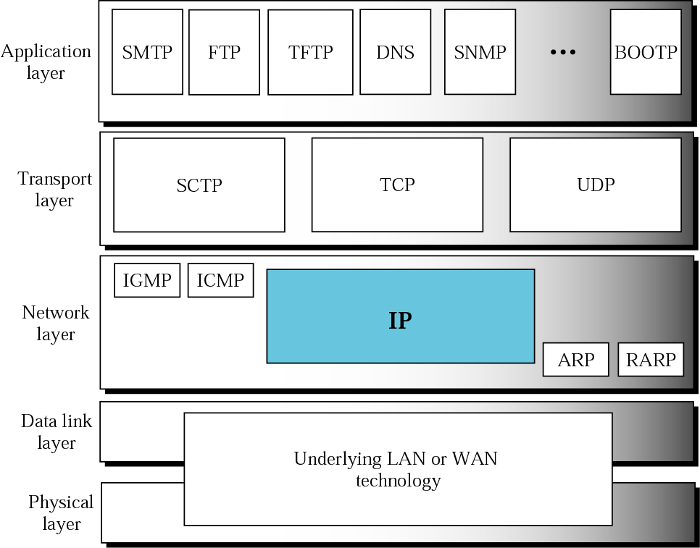
Position of IP in TCP/IP protocol suite

Slide 3
Internet Protocol Datagram
A packet in the IP layer is called a datagram,
A variable-length packet consisting of two parts: header and data.
The header is 20 to 60 bytes in length and contains information essential to routing and delivery.

Slide 4
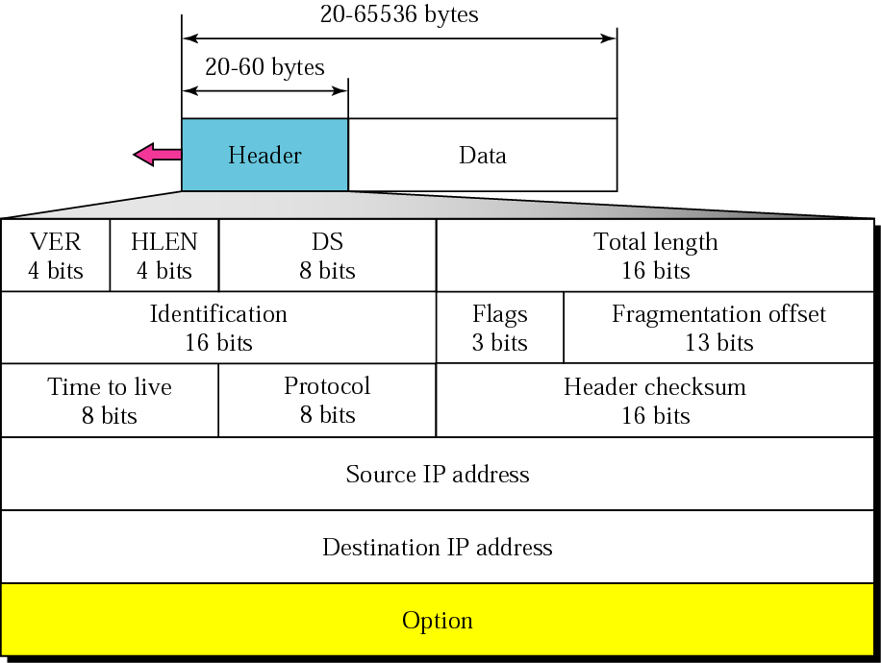
IP datagram

Slide 5
IP Datagram
Version: current IP version is 4.
Internet header length (IHL) or HLEN: length of the header in 32-bit words.(5 no options)
  When no options are there HLEN is 20 bytes and value of the field is 5 (5 *4 = 20).
  When option field is set at maximum then it can be 60 bytes and value of the field is 15 (15 *4 = 60)
Differentiated Services(DS): Earlier called as service type.
  Precedence: (3 bits) Defines priority of datagram during congestion.

Slide 6
IP Datagram
  TOS – 4bits (Type of service)
      0000 Default[ ICMP, DNS)
      0001 Minimize cost(NNTP)
      0010 Maximize Reliability(SNMP)
      0100 Maximize Throughput(FTP, SMTP)
      1000 Minimize Delay(FTP,TFTP)
  When 3 right most bits are 0’s,3 left most bits are precedence bits.
  When 3 right most bits are not 0’s, the 6 bits define 64 services based on the priority assignment by internet or local authorities.
  ie) Interactive activities, Activities requiring immediate response need minimum delay
  Sending bulk data requires Maximum throughput.
  Management activities require maximum reliability
  Background activities require minimum cost.
By R VIJAYAN,Assistant Professor(Sr),SITE,VIT University

Slide 7
IP Datagram
Total length:16 bits[header + data]
  Length of data = total length – header length
        = 2¹⁶ - 20 or 60 bytes
Identification, Flags, fragmentation offset are used in fragmentation
Time to live (TTL): number of hops packet is allowed to traverse in the network.
  Each router along the path to the destination decrements this value by one.
  If the value reaches zero before the packet reaches the destination, the router discards the packet and sends an error message back to the source.
Protocol:defines higher level protocol(TCP,UDP)

Slide 8
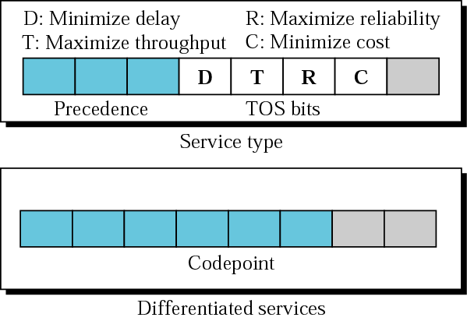
Service type or differentiated services

Slide 9
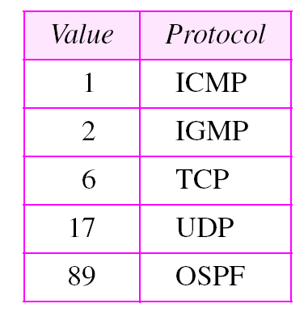
Protocol type

Slide 10

Note:
The precedence subfield was designed, but never used in version 4.

Slide 11
Note:
The total length field defines the total length of the datagram including the header.

Slide 12
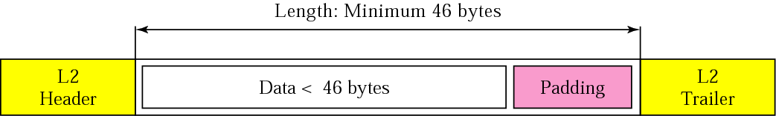
Encapsulation of a small datagram in an Ethernet frame

Slide 13
FRAGMENTATION
The format and size of a frame depend on the protocol used by the physical network. A IP datagram may have to be fragmented to fit the protocol regulations.
Maximum Transfer Unit (MTU)
Fields Related to Fragmentation

Slide 14
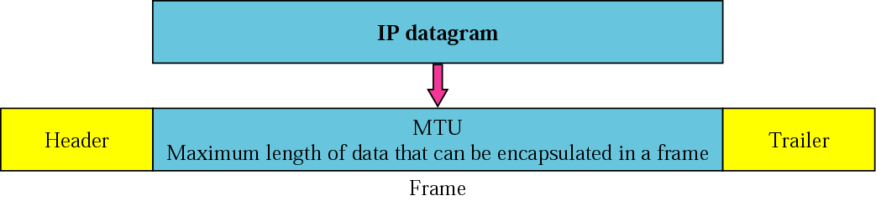
Maximum Transfer Unit (MTU)

Slide 15
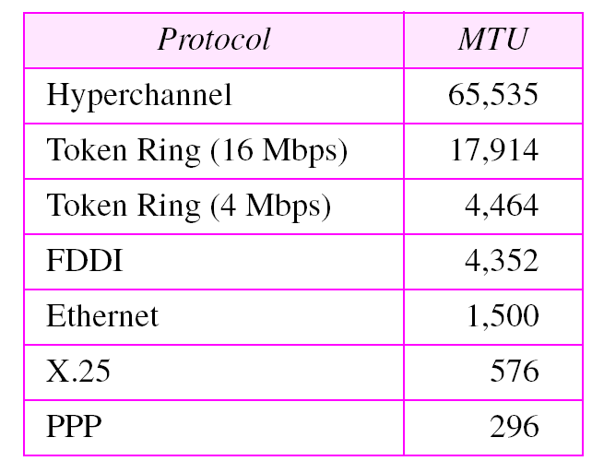
MTUs for some networks

Slide 16
Fragmentation and Reassembly
Reassemble
at destination
Source
Router
Destination
Fragment
at source
Fragment
at router
IP
IP
Network
Network

Slide 17
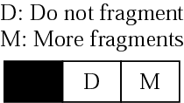
Fragmentation Details
Identification: [16 bits] Gives ID of source host and its unique.
  When datagram is fragmented the ID is copied to all fragments. This would help the destination to reassemble the datagram based on ID.
Flags: [3 bits]
  D- do not fragment: if its 1, then the datagram must not be fragmented.[ It is discarded if it cannot be passed through the physical network and sends an ICMP error message]. It is fragmented if its 0.
  M – More fragments:1- some more fragments are following, 0 – it’s the last fragment or only fragment

Slide 18
Fragmentation Details
Fragmentation Offset: [13 bits]
  Shows the relative position of this fragment w.r.t the whole datagram.
  identifies the location of a fragment within a packet in units of 8bytes
  Eg. 4000 bytes fragmented into 3 fragments.
[Units of 8 bytes because offset field is 13 bits and cannot represent sequence greater than 8191.]
1st fragment: 0 – 1399[offset is 0/8=0]
2nd fragment: 1400 – 2799[offset is 1400/8 = 175]
3rd fragment: 2800 – 3999[offset is 2800/8 = 350]

Slide 19
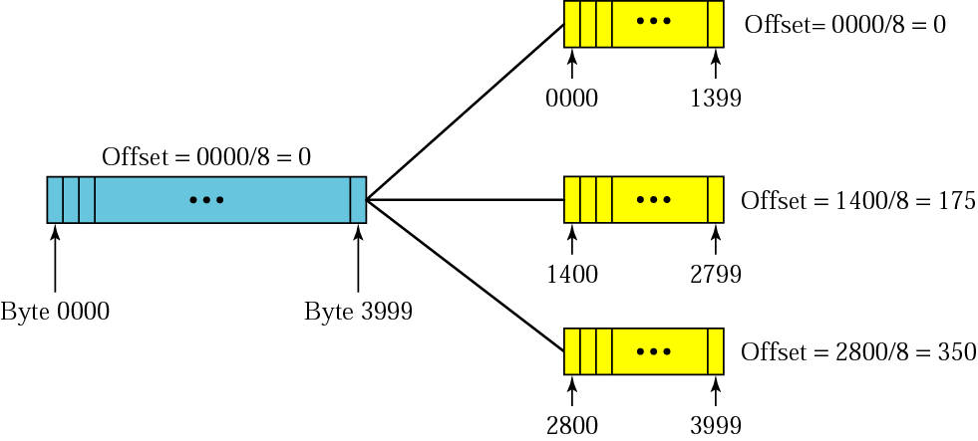
Fragmentation example

Slide 20
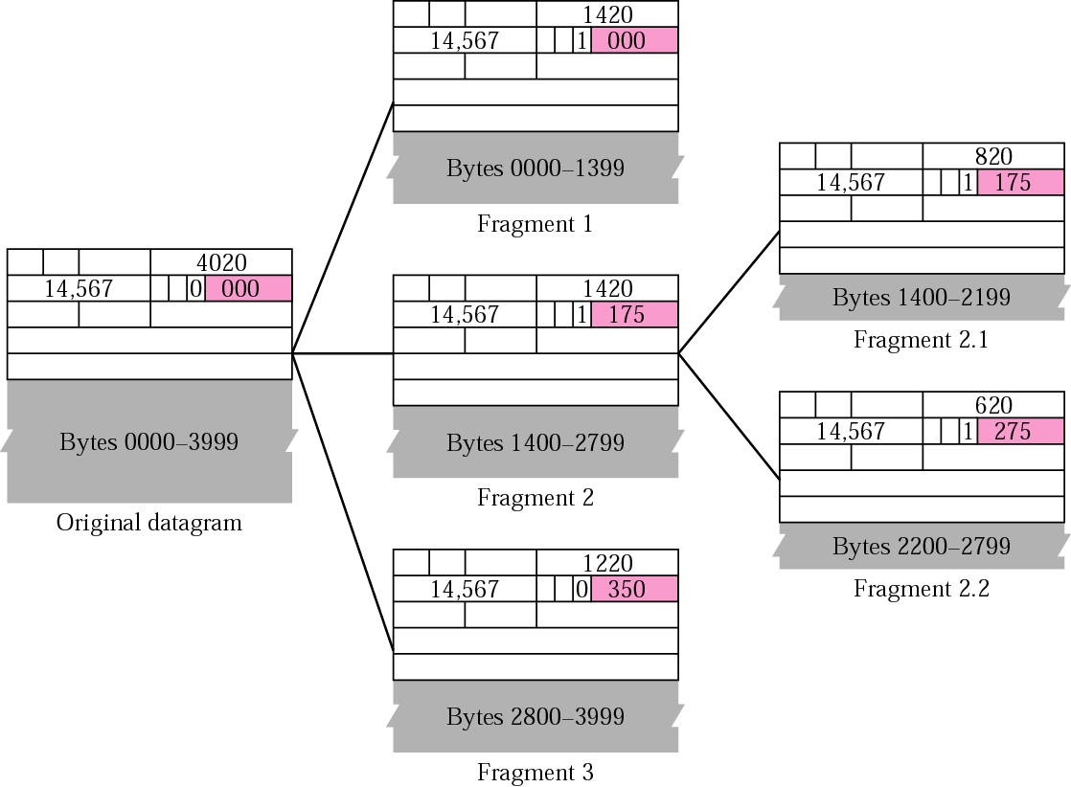
Detailed fragmentation example

Slide 21
Example 2
A packet has arrived with an M bit value of 0. Is this the first fragment, the last fragment, or a middle fragment? Do we know if the packet was fragmented?
Solution
If the M bit is 0, it means that there are no more fragments; the fragment is the last one. However, we cannot say if the original packet was fragmented or not. A nonfragmented packet is considered the last fragment.
TCP/IP Protocol Suite

Slide 22
Example 3
A packet has arrived with an M bit value of 1. Is this the first fragment, the last fragment, or a middle fragment? Do we know if the packet was fragmented?
Solution
If the M bit is 1, it means that there is at least one more fragment. This fragment can be the first one or a middle one, but not the last one. We don’t know if it is the first one or a middle one; we need more information (the value of the fragmentation offset). See also the next example.
TCP/IP Protocol Suite

Slide 23
Example 4
A packet has arrived with an M bit value of 1 and a fragmentation offset value of zero. Is this the first fragment, the last fragment, or a middle fragment?.
Solution
Because the M bit is 1, it is either the first fragment or a middle one. Because the offset value is 0, it is the first fragment.
TCP/IP Protocol Suite

Slide 24
Example 5
A packet has arrived in which the offset value is 100. What is the number of the first byte? Do we know the number of the last byte?
Solution
To find the number of the first byte, we multiply the offset value by 8. This means that the first byte number is 800. We cannot determine the number of the last byte unless we know the length of the data.
TCP/IP Protocol Suite

Slide 25
Example 6
A packet has arrived in which the offset value is 100, the value of HLEN is 5 and the value of the total length field is 100. What is the number of the first byte and the last byte?
Solution
The first byte number is 100 × 8 = 800. The total length is 100 bytes and the header length is 20 bytes (5 × 4), which means that there are 80 bytes in this datagram. If the first byte number is 800, the last byte number must be 879.
TCP/IP Protocol Suite

Slide 26
Example: Fragmenting a Packet
A packet is to be forwarded to a network with MTU of 576 bytes. The packet has an IP header of 20 bytes and a data part of 1484 bytes. and of each fragment.
Maximum data length per fragment = 576 - 20 = 556 bytes.
We set maximum data length to 552 bytes to get multiple of 8.
 | Total Length | Id | MF | Fragment Offset
Original packet | 1504 | x | 0 | 0
Fragment 1 | 572 | x | 1 | 0
Fragment 2 | 572 | x | 1 | 69
Fragment 3 | 400 | x | 0 | 138

Slide 27
Problem-1
Suppose a router receives an IP packet containing 1400 data bytes and has to forward the packet to a network with maximum transmission unit of 620 bytes. Assume that the IP header is 20 bytes long. Show the fragments that the router creates and specify the relevant values in each fragment header (i.e., total length, fragment offset, and more bit).

Slide 28
 | Total Length | Id | MF | Fragment Offset
Original packet | 1420 | x | 0 | 0
Fragment 1 | 620 | x | 1 | 0
Fragment 2 | 620 | x | 1 | 75
Fragment 3 | 220 | x | 0 | 150

Slide 29
Problem-2
Suppose a router receives an IP packet containing 600 data bytes and has to forward the packet to a network with maximum transmission unit of 200 bytes. Assume that the IP header is 20 bytes long. Show the fragments that the router creates and specify the relevant values in each fragment header (i.e., total length, fragment offset, and more bit).

Slide 30
 | Total Length | Id | MF | Fragment Offset
Original packet | 620 | x | 0 | 0
Fragment 1 | 196 | x | 1 | 0
Fragment 2 | 196 | x | 1 | 22
Fragment 3 | 196 | x | 1 | 44
Fragment 4 | 92 | x | 0 | 66

Slide 31
OPTIONS
The header of the IP datagram is made of two parts: a fixed part and a variable part. The variable part comprises the options that can be a maximum of 40 bytes.
Options are used for network testing and debugging

Slide 32
Options
No operation option
  Used as a filler to align the next option
End of option option
  Used for padding, it follows with payload data
Record route option
  Records the internet routers that handles the datagram
  Can line upto 9 router IP addresses since max.size of header is 60 bytes[20base header + 40 options]
Strict source route option
  Used by the source to predetermine the route for a datagram as it travels through internet. All the routers defined in the option must be visited.
Loose source route option
  Each router in the list must be visited, but the datagram can visit other routers also.
Timestamp option
  Used to record the time of datagram processing by a router.
  Universal time is expressed in milliseconds.

Slide 33
Internet Control Message
Protocol
(ICMP)

Slide 34
IP protocol is a best effort delivery that delivers a datagram from its original source to its final destination.
  Deficiencies are : Lack of error control and Lack of assistance mechanisms.
IP doesn’t have built-in mechanisms to notify regarding the errors to the original host.
  ICMP is designed to compensate the above deficiencies.
ICMP messages are encapsulated inside IP datagram's before sending to the DLL.
RFC 792; Encapsulated in IP packet (protocol type = 1)
Handles error and control messages

Slide 35
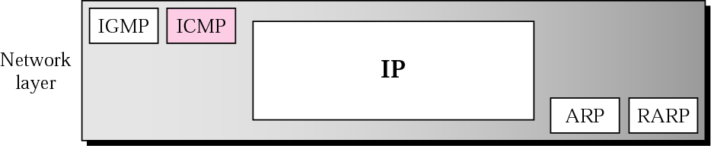
Position of ICMP in the network layer

Slide 36
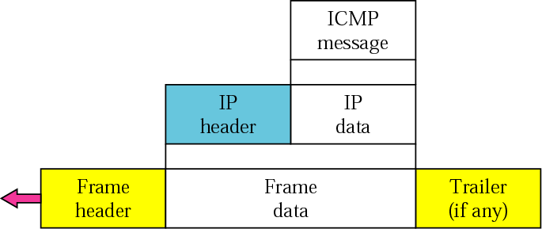
ICMP encapsulation

Slide 37
TYPES OF MESSAGES
ICMP messages are divided into
Error-reporting messages
Query messages
The error-reporting messages report problems that a router or a host (destination) may encounter.
The query messages get specific information from a router or another host.

Slide 38
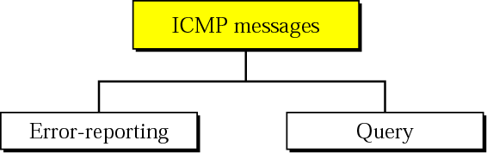
ICMP messages

Slide 39
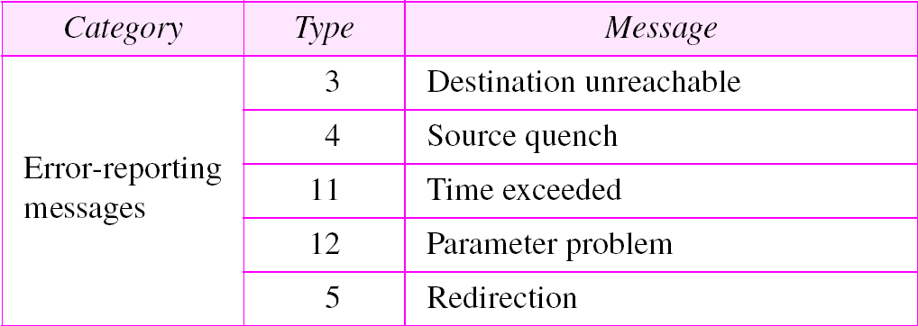
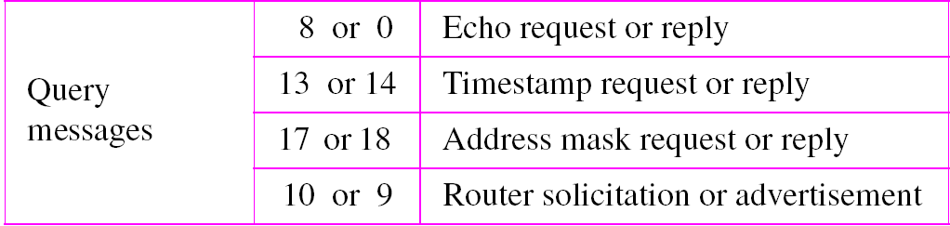
ICMP messages

Slide 40
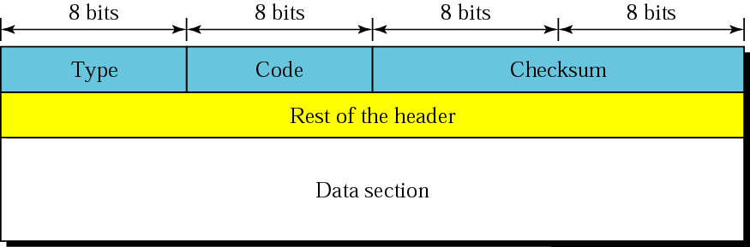
MESSAGE FORMAT
ICMP message has an 8-byte header and a variable-size data section.
First 4 bytes are common to all.

Slide 41
ICMP Basic Error Message Format
0 8 16 31
Type Code Checksum
Unused
IP header and 64 bits of original datagram
Type of message:Defines the type of message
Code: Specifies the reason for the particular message (purpose of message)
Checksum – Used for error detection
In error messages, Data Section carries information for finding the original packet that had the error.
In query messages, Data Section carries extra information based on type of the query.
IP header & 64 bits of original datagram
  To match ICMP message with original data in IP packet

Slide 42
ERROR REPORTING
IP, as an unreliable protocol, is not concerned with error checking and error control.
ICMP was designed, in part, to compensate for this shortcoming.
ICMP does not correct errors, it simply reports them to the original source.

Slide 43
Note:
ICMP always reports error messages to the original source.

Slide 44
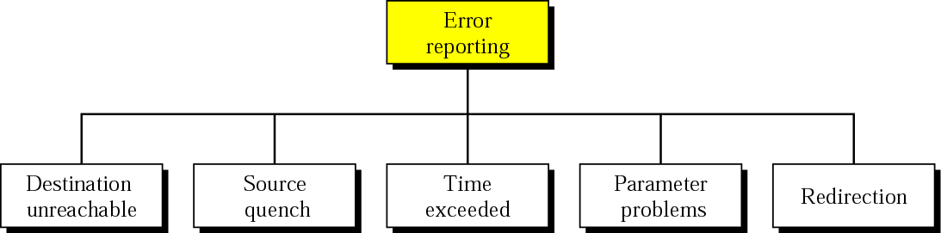
Error-reporting messages

Slide 45
Note:
The following are important points about ICMP error messages:
❏ No ICMP error message will be generated in response
to a datagram carrying an ICMP error message.
❏ No ICMP error message will be generated for a
fragmented datagram that is not the first fragment.
❏ No ICMP error message will be generated for a
datagram having a multicast address.
❏ No ICMP error message will be generated for a
datagram having a special address such as 127.0.0.0 or
0.0.0.0.

Slide 46
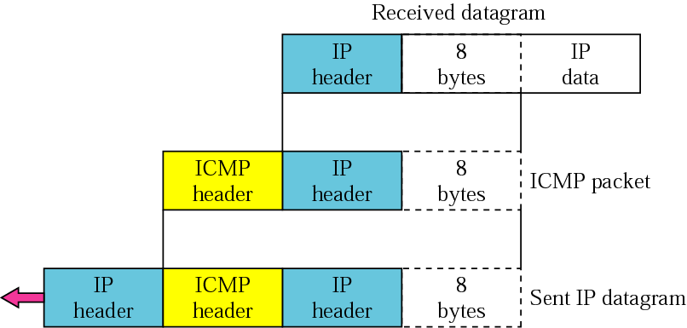
Contents of data field for the error messages

Slide 47
ICMP Destination-unreachable message(Type 3)
When a router can’t route a datagram[or] a host can’t deliver a datagram, the datagram is discarded and the router or the host sends a destination unreachable message back to the source host that initiated the datagram
Code
  0 = network unreachable; due to hardware failure
  1 = host unreachable; also due to hardware failure
  2 = protocol unreachable;[if particular protocol like TCP is not running at the moment, destination host sends this message.
  3 = port unreachable; [application program is not running]
  4 = fragmentation needed and DF set;
  5 = source route failed as source routing option cannot be visited.

Slide 48
ICMP Destination-unreachable message(Type 3)
Code
  6 = Destination Network unknown [Router has no information about the destination network].
  7 = Destination Host unknown [Router is unaware of the existence of the destination host]
  8=Source host is isolated
  9=communication with dest network is prohibited.
  10=communication with dest host is prohibited.
  11=network is unreachable for specified type of service.
  12=host is unreachable for specified type of service.
  13=host is unreachable due to admin filter on it.
  14= host is unreachable due to the precedence is violated.
  15=host is unreachable due to its precedence was cut off.

Slide 49
ICMP error reporting messages
Source-quench message
  informs the source that a datagram has been discarded due to congestion in a router or the destination host.
  The source must slow down the sending of datagrams until the congestion is relieved.
Time-exceeded message
  Whenever a router decrements a datagram with a time-to-live value to zero, it discards the datagram and sends a time-exceeded message to the original source.
Parameter-problem message
  created by a router or the destination host when there is ambiguity or missing value in the header of a datagram.
Redirection message
  A host usually starts with a small routing table that is gradually augmented and updated using this message
  sent from a router to a host on the same local network.

Slide 50
QUERY
ICMP can also diagnose some network problems through the query messages, a group of four different pairs of messages. In this type of ICMP message, a node sends a message that is answered in a specific format by the destination node.
Echo Request and Reply
Timestamp Request and Reply
Address-Mask Request and Reply
Router Solicitation and Advertisement

Slide 51
Echo Request & Echo Reply Message Format
0 8 16 31
Type Code=0 Checksum
Identifier Sequence number
Data
Helps determine if there is communication at the IP level.
Echo request and reply messages are designed for diagnostic purposes.
It can determine whether a node is functioning properly or not.
Echo request: type=8; Echo reply: type=0
  Destination replies with echo reply by copying data in request onto reply message
Sequence number to match reply to request
ID to distinguish between different sessions using echo services
Used in PING

Slide 52
ICMP query messages
Timestamp Request and Reply
  Can be used to synchronize the clocks in two machines.
  Measured in milliseconds from midnight in Universal Time.
  Source creates timestamp request message with original timestamp field with the time at departure.
  Destination creates timestamp reply message. It fills the receive timestamp field with the value from its clock when it received the request message.
  Transmit timestamp is filled at the time the reply message departs.
Mask request and reply
  A host that knows its IP address and doesn’t know the mask sends an address mask request message. This request can be broadcast.
  The router receiving the address mask request message responds with an address mask reply message providing the mask for the host.

Slide 53
ICMP query messages
Router-solicitation message
  Used when a host must know if the routers are alive and functioning.
  A host can broadcast a router solicitation message.
Router-advertisement message
  The routers that receive solicitation message broadcast their routing information using the router advertisement message.

